Slide 1
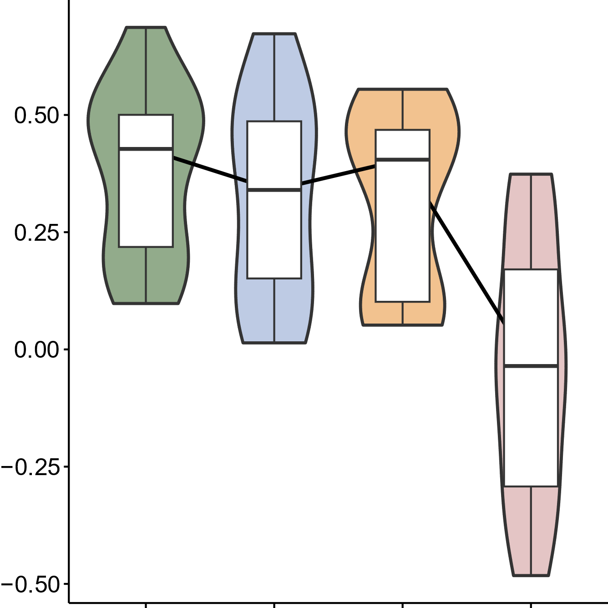
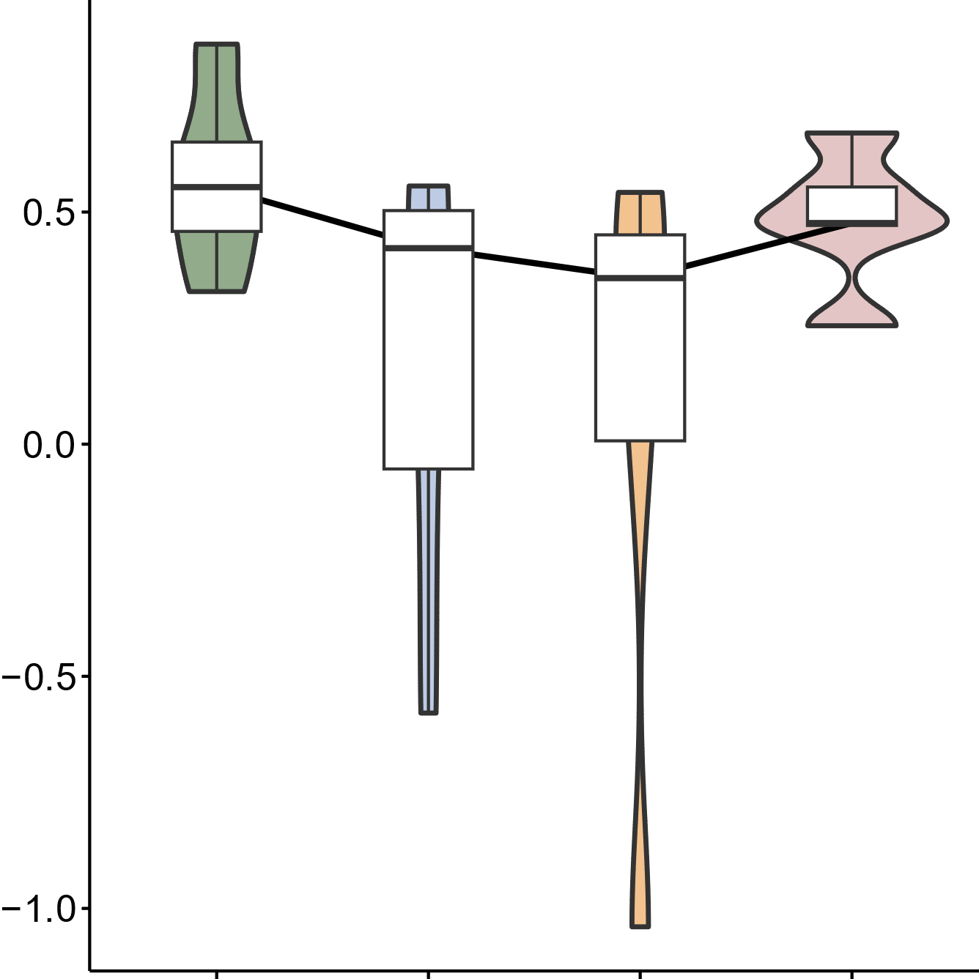
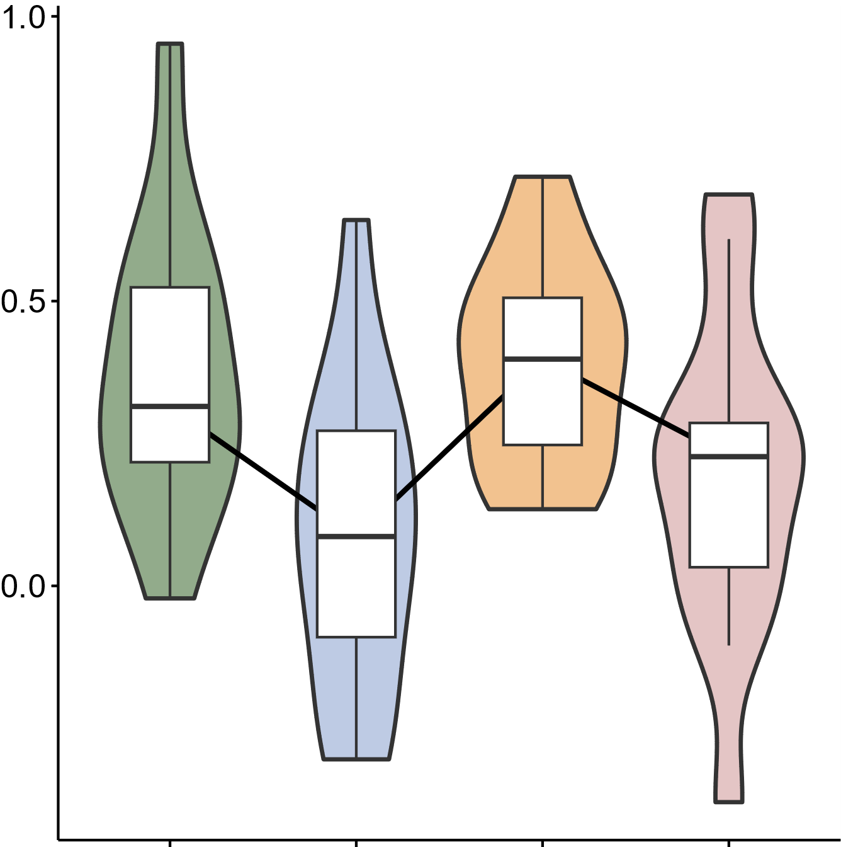
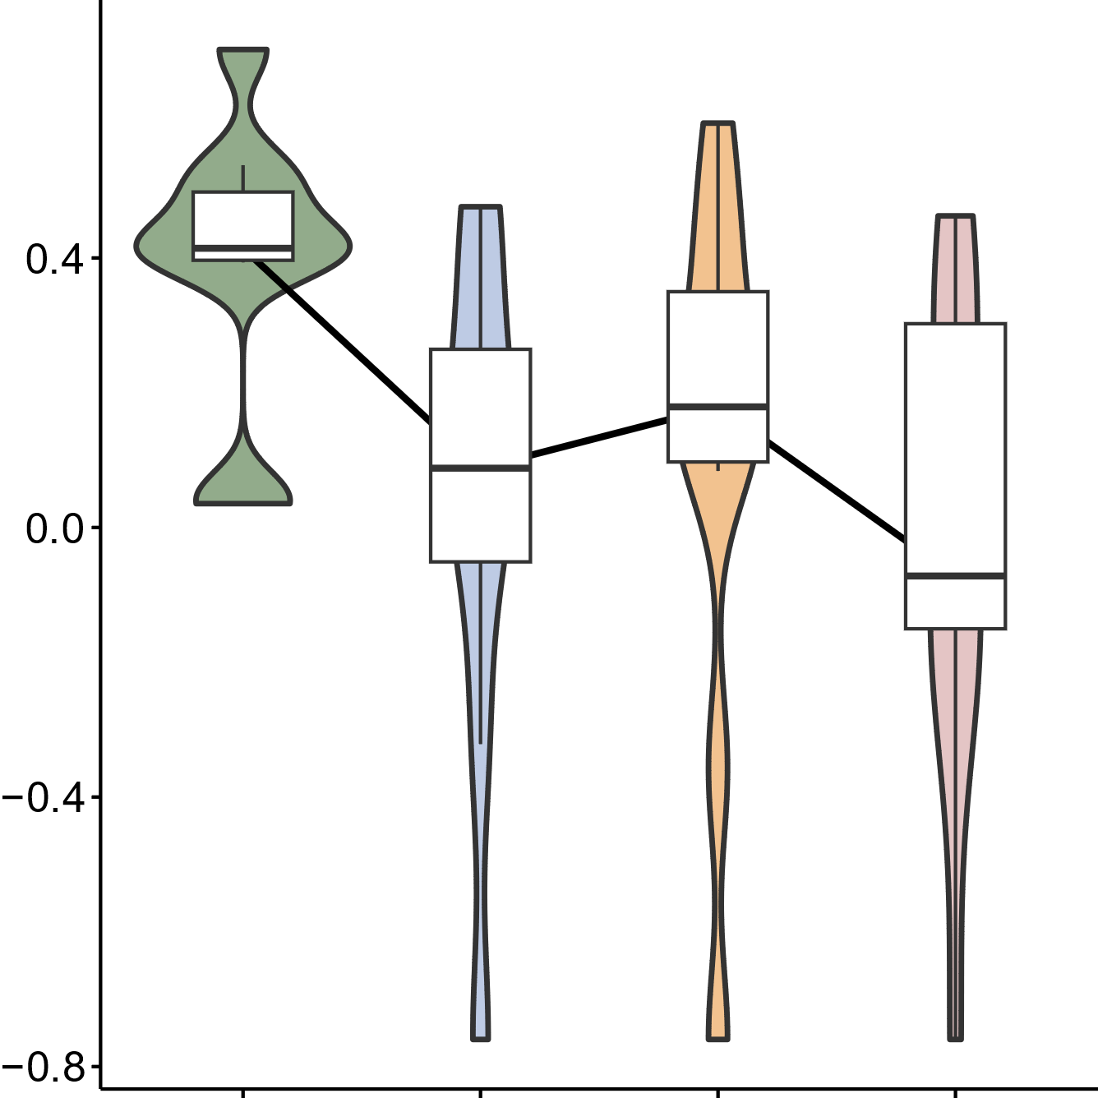
Relative abundance
-1
0
1
0.50
0.25
0.00
-0.25
-0.50
0.50
0.00
-0.50
Median relative abundance of metabolites
-1.0
1.0
0.50
0.00
0.40
0.00
-0.40
-0.8
Disease remission
Disease remission
Low disease activity
Low disease activity
High disease activity
High disease activity
Moderate disease activity
Moderate disease activity

